Slide 1

EMOTION IDENTIFICATION THROUGH FACIAL RECOGNITION
Project 2

Slide 2
Group Members
Erick Esparza
Michael Dionne
Sterling Davis
Leo

Slide 3
EXECUTIVE SUMMARY
Our goal was to utilize various images to source through facial recognition.
We used a nonbinary classification model to analyze whether a person’s facial expression was happy, sad, angry, fearful, surprised or neutral. We decided to use this type of model, so that it could grant us the ability to decipher a range of emotions on a person’s face, rather than just one or two.
By using a diverse set of tools such as Keras, Matplotlib and cb2, we were then able to predict what emotions a person may be experiencing based on a snapshot of their face.
Notes:
An executive summary of the project and project goals. (5 points)
Explain how this project relates to fintech and machine learning.

Slide 4
DATA PREPARATION
Dataset from Kaggle contains different expressions of the human face (happy, sad, angry, neutral, surprise, fear, disgust)
The training set contains 28,273 images and the test set contains 7,067 images of facial expressions
Image generation: 150 x 150 x 3,
Rescale to 1.0/255 to reduce resources (RGB is 0-255)
Notes:
https://www.kaggle.com/code/yassineghouzam/introduction-to-cnn-keras-0-997-top-6
https://www.kaggle.com/code/nguyendaitruongthanh/facial-emotion-detection-with-cnn

Slide 5
MODEL TRAINING PROCESS
# model = RMS Optimizer, Relu Activation
# model_adam = ADAM optimizer, Relu Activation
# model_swish = RMS Optimizer, Swish Activation
# model_adam_swish = ADAM Optimizer, Swish Activation
# model_CNN = Convolutional Neural Network

Slide 6
Model Training Process: Resource management
Optimizers
Vanishing Gradient Problem
Activation Function

Slide 7
Optimizers
Animation of 5 gradient descent methods :
gradient descent (cyan), momentum (magenta),
AdaGrad (white),
RMSProp (green),
Adam (blue)
Left well is the global minimum;
right well is a local minimum.
Notes:
Gradient Descent Visualization
Now here’s a short answer to your question without diving into too many of the details. Essentially, the typical optimization problem generally comes from performing something like a ML or MAP parameter estimate using some assumed parametric distribution that your data stems from. Performing a ML or MAP parameter estimate requires solving an optimization problem, so your goal is to find the global optimal solution of this! This is in essence why we strive to get as close to the global optimal solution when we use gradient descent to estimate parameters for some model.
RMSProp
The problem of AdaGrad, however, is that it is incredibly slow. This is because the sum of gradient squared only grows and never shrinks. RMSProp (for Root Mean Square Propagation) fixes this issue by adding a decay factor.
Adam
Last but not least, Adam (short for Adaptive Moment Estimation) takes the best of both worlds of Momentum and RMSProp.
Resource
https://towardsdatascience.com/a-visual-explanation-of-gradient-descent-methods-momentum-adagrad-rmsprop-adam-f898b102325c

Slide 8
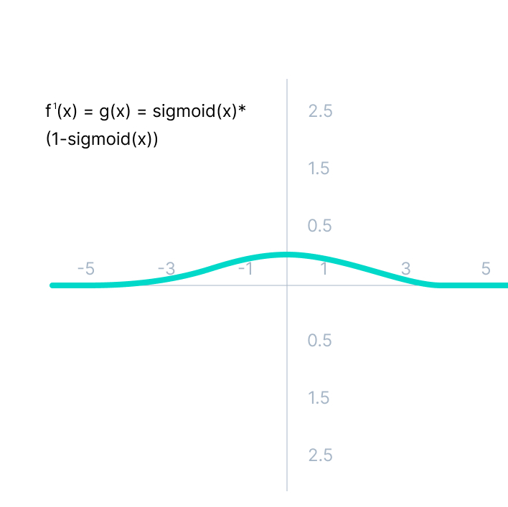
VANISHING GRADIENT PROBLEM
Sigmoid Activation Function
Values beyond 3 & -3 are flatter so their function will have smaller gradients.
Eventually reach zero.
Network ceases to learn.
(Logistic function is not symmetric at zero so the output will all be the same sign = unstable NN = more difficult training)
Notes:
As we can see from the above Figure, the gradient values are only significant for range -3 to 3, and the graph gets much flatter in other regions.
It implies that for values greater than 3 or less than -3, the function will have very small gradients. As the gradient value approaches zero, the network ceases to learn and suffers from the Vanishing gradient problem.
The output of the logistic function is not symmetric around zero. So the output of all the neurons will be of the same sign. This makes the training of the neural network more difficult and unstable.

Slide 9
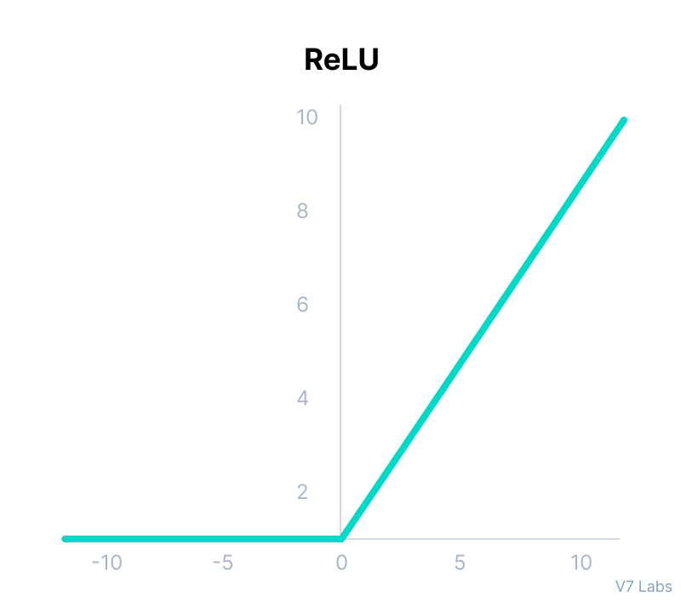
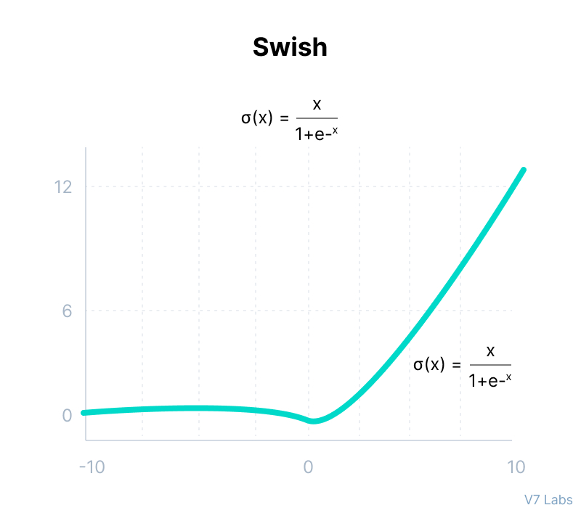
RECTIFIED LINEAR UNIT & SWISH ACTIVATION FUNCTIONS ARE COMPUTATIONALLY EFFICIENT
NEURONS DEACTIVATED IF OUTPUT LESS THAN ZERO.
ACCELERATES THE CONVERGENCE TOWARDS THE GLOBAL MIN.
SMOOTH FUNCTION AT ZERO
SMALL NEGATIVE VALUES ARE KEPT WHICH CAN BE RELEVANT.
Notes:
Although it gives an impression of a linear function, ReLU has a derivative function and allows for backpropagation while simultaneously making it computationally efficient.
The main catch here is that the ReLU function does not activate all the neurons at the same time.
The neurons will only be deactivated if the output of the linear transformation is less than 0.
The advantages of using ReLU as an activation function are as follows:
Since only a certain number of neurons are activated, the ReLU function is far more computationally efficient when compared to the sigmoid and tanh functions.
ReLU accelerates the convergence of gradient descent towards the global minimum of the loss function due to its linear, non-saturating property.
The limitations faced by this function are:
The Dying ReLU problem, which I explained below.
---------------------------------------
Swish
It is a self-gated activation function developed by researchers at Google.
Swish consistently matches or outperforms ReLU activation function on deep networks applied to various challenging domains such as image classification, machine translation etc.

Slide 10
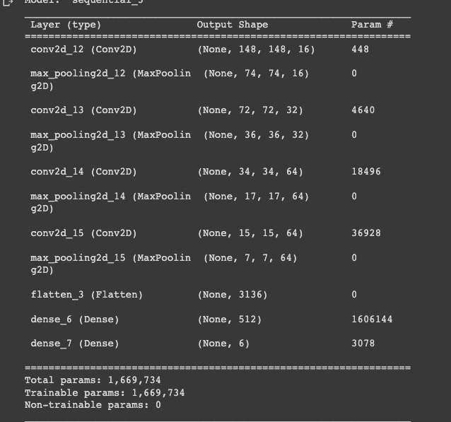
Which would you choose?

Slide 11
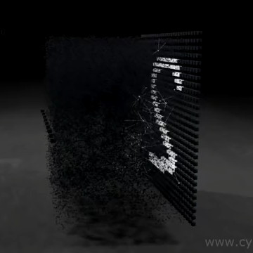
Selected Model
Model_adam_swish:
Swish Activation Function
Adam Optimizer
54.2% Accuracy
Notes:
### Conclusion
The most accurate model (Model_adam_swish) was the model with the swish activation function and the adam optimizer. (54.2% accuracy)
The least accurate model (Model_Adam) was the model with the relu activation function and the adam optimizer. (15.5% accuracy)

Slide 12
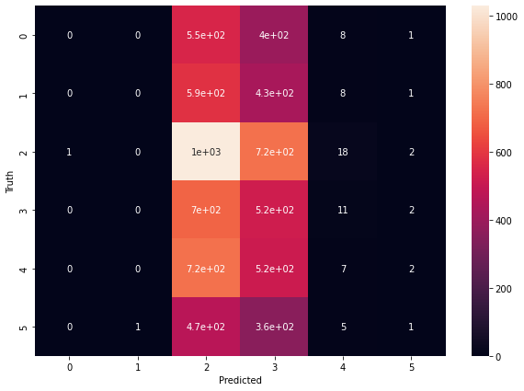
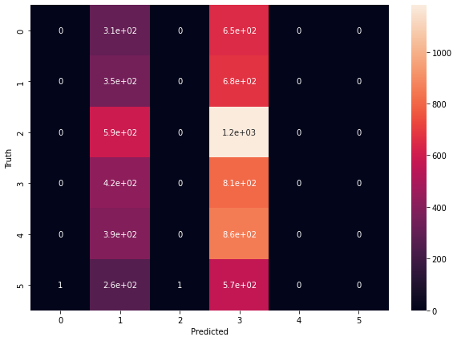
Confusion Matrix / Validation Generator
Swish Activation / Adam Optimization
54.2 % Accurate
Relu Activation / Adam Optimization
15.5 %Accurate
Notes:
The most accurate model (Model_adam_swish) was the model with the swish activation function and the adam optimizer. (54.2% accuracy)
The least accurate model (Model_Adam) was the model with the relu activation function and the adam optimizer. (15.5% accuracy)

Slide 13
APPROACH TO ACHIEVE PROJECT GOALS

Slide 15
RESULTS & CONCLUSIONS
We tested five different models, and concluded that the Adam Swish activation function, and Adam Relu activation function were both the most accurate models.
The most accurate model (Model_adam_swish) was the model with the swish activation function and the adam optimizer. (54.2% accuracy)
The least accurate model (Model_Adam) was the model with the relu activation function and the adam optimizer. (15.5% accuracy)
Notes:
### Conclusion
The most accurate model (Model_adam_swish) was the model with the swish activation function and the adam optimizer. (54.2% accuracy)
The least accurate model (Model_Adam) was the model with the relu activation function and the adam optimizer. (15.5% accuracy)
—--------------------------
114/114 - 5s - loss: 1.2472 - accuracy: 0.5166 - 5s/epoch - 42ms/step
Model Loss: 1.2471790313720703, Model Accuracy: 0.5166265964508057
114/114 - 4s - loss: 1.7921 - accuracy: 0.1558 - 4s/epoch - 37ms/step
Model_Adam Loss: 1.7920674085617065, Model_Adam Accuracy: 0.15579453110694885
114/114 - 4s - loss: 1.1649 - accuracy: 0.5500 - 4s/epoch - 37ms/step
Model_swish Loss: 1.1649253368377686, Model_swish Accuracy: 0.550021231174469
14/114 - 4s - loss: 1.1808 - accuracy: 0.5424 - 4s/epoch - 37ms/step
Model_adam_swish Loss: 1.1808154582977295, Model_adam_swish Accuracy: 0.5423800945281982
114/114 - 4s - loss: 1.1758 - accuracy: 0.5465 - 4s/epoch - 39ms/step
Model_cnn Loss: 1.1758086681365967, Model_cnn Accuracy: 0.5464836359024048
### Conclusion
The most accurate model was the model with the swish activation function and the adam optimizer.
The model with the swish activation function and the rms optimizer was the second most accurate model.
The model with the relu activation function and the adam optimizer was the third most accurate model.
The model with the relu activation function and the rms optimizer was the fourth most accurate model.
The model with the convoluting neural network was the least accurate model.

Slide 16
NEXT STEPS
More Data
More Testing
Body language analysis
Motion capture

